Slide 1
Graduate Admission Analysis & Prediction
Team Id : Team_4331
College Name : R.N.G. Patel Institute Of Technology
Team Leader : Dev Ashvinbhai Patel
Members :
Kirtan Nileshbhai Tank
Anup Rajeshbhai Tailor
Jeel Vireshbhai Patel

Slide 2
AGENDA
Objective 1 : To know the likelihood of various aspect of the different parameters responsible for the prediction of chance of admit of the student.
Objective 2 : To know the fitness of different machine learning model such as Multiple Linear Regression, Polynomial Regression , Elastic net Regression, Random Forest Regression and SVM Regression. To apply comparative analysis on basis of mean absolute error, mean square error & root mean square error.
Objective 3 : To deploy a web application to make it easy for student just pass the input and get the desired result without getting into lengthy documentation.

Slide 3
PROBLEM STATEMENT
Student admission problem is very important in educational institutions. The issue of student admittance is crucial for educational institutions. In this project, machine learning algorithms are used to forecast a student's likelihood of admission to a master's degree. Students will benefit from knowing in advance whether they stand a chance of being admitted. The machine learning models include random forest, k-nearest neighbor, and multiple linear regression.

Slide 4

PROJECT OVERVIEW
Introduction:
Graduate admission analysis and prediction is a data science project that involves analyzing data related to students' applications for graduate studies and using machine learning algorithms to predict their chances of admission. The project aims to help universities and students make informed decisions based on the student's profile and increase the transparency of the admission process.

Slide 5
PROJECT OVERVIEW
Project Objectives:
Analyze the dataset and identify the factors that affect the admission process.
Develop machine learning models that predict the chances of admission based on student profiles.
Evaluate the performance of different machine learning algorithms and select the best performing one.
Visualize the results and present them in an easy-to-understand format.

Slide 6
PROJECT OVERVIEW
Methodology:
Data Collection: Collect the admission dataset from reliable sources (Graduate Admission 2 | Kaggle).
Data Cleaning: Clean the dataset by removing duplicates, handling missing values, and outliers.
Exploratory Data Analysis: Analyze the data to identify patterns, trends, and relationships between variables.
Feature Engineering: Identify the most relevant features and engineer them to improve the model's accuracy.
Model Selection: Train and evaluate different machine learning algorithms, such as linear regression, random forest, and support vector machine, to select the best performing one.
Model Evaluation: Evaluate the model's performance using metrics such as accuracy,mse,mae and rmse.
Deployment: Deploy the machine learning model as a web application using frameworks such as Streamlit.

Slide 7
PROJECT OVERVIEW
Expected Outcomes:
An accurate machine learning model that predicts the chances of admission based on student profiles.
Insights into the factors that affect the admission process.
A web application that allows students to check their chances of admission based on their profile and helps universities in their admission process.

Slide 8
WHO ARE THE END USERS?
Our end users are specifically the student who want to study abroad for master degree after completing their bachelor degree.
These student appears in various exam such as :
TOEFL (Test of English as a Foreign Language): It is an English language proficiency exam accepted by most universities in the USA and Canada
GRE (Graduate Record Examination): It is a standardized test required for admission to graduate programs in the USA and Canada.
Our analysis can also be used for study purpose by the student or the researcher belonging to Data science field.

Slide 9
THE WOW FACTOR IN OUR SOLUTION
The use of machine learning algorithms to predict the likelihood of admission based on a variety of factors. This would make the application process more efficient for students and help universities streamline their admissions process.
The dynamic web application just using slider and get your desire result within second.This web application will be stateless so that it will not store the user data.

Slide 10
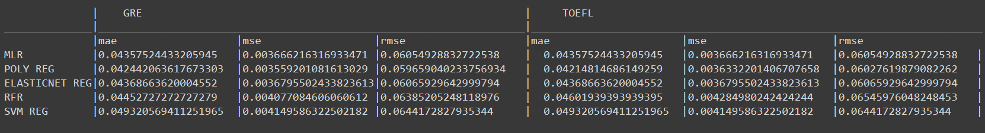
MODELLING
We have done the comparative analysis on the different model such as Multiple Linear Regression, Polynomial Regression, Elastic net Regression, Random Forest Regression and SVM Regression.
Below snip show the mean absolute error, mean square error and root mean square error on two different parameters GRE and TOEFL. In which the Polynomial Regression use to be perform little bit more efficiently than the other model.

Slide 11
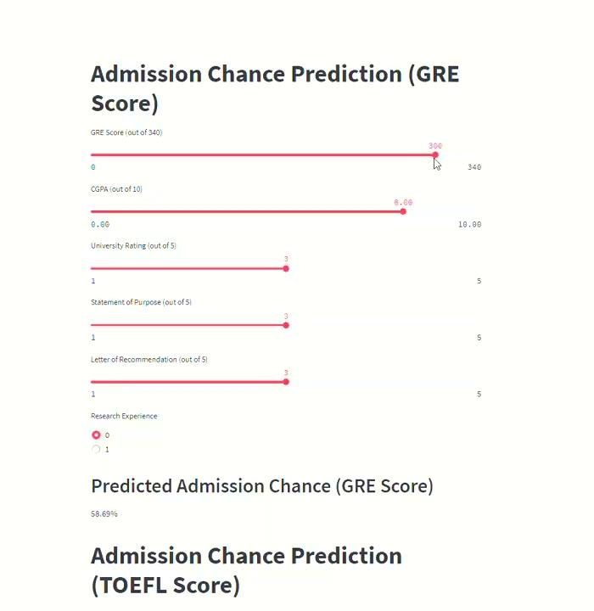

RESULTS
Our model predict accurately over the different parameter and inputs of the users
Overall, the result of a graduate admission analysis and prediction project is a valuable resource for students, educators, and institutions alike, helping to improve the college application process and increase access to higher education opportunities.
The following videolink is the illustration how our website
Works.
Link : Admission_predictor_video_illustration.mp4
Github Link : Graduate-Admission-Analysis-and-Prediction

Slide 12
CONCLUSION
Graduate admission analysis and prediction is an important project that helps universities and students make informed decisions. The project involves collecting, cleaning, analyzing, and visualizing data and developing machine learning models that predict the chances of admission. The project can be extended by adding more features and exploring more machine learning algorithms.

Slide 13




MEET OUR TEAM
Dev Patel
ML Model Development & Model Deployment
Kirtan Tank
Feature Engineering & ML Model Development
Anup Tailor
Web Development
Jeel Patel
Content Creation

